Slide 1
Physics 201
Winter 2013
Kinematics of rotation

Slide 2

Radians are the “natural” way to measure angle
Winter 2013
Arc-length is proportional to both the angle and the radius of the circle – in symbols:
We can simplify with a new unit for angle:
Using radians creates a cleaner expression for
arc-length:

Slide 3


Rotation is change in orientation
Winter 2013
We must define orientation relative to some reference orientation (i.e., north or “positive-x”)
Rotation is described via angular velocity and angular acceleration
There is an analogy between the definitions of linear and angular motion

Slide 4




Kinematics of rotation
Winter 2013
Remember me?
Show me

Slide 5
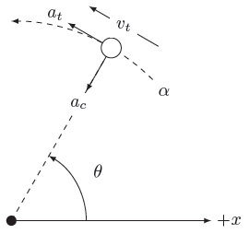

The parts of a rigid object rotate together
Winter 2013
Tangential components
Radial components
Show me

Slide 6
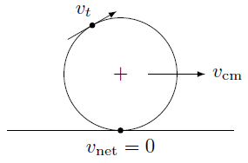
Condition for things that are rolling
Winter 2013
Slipping:
Sliding:

